Slide 1
UNIT-III
Hidden Markov Models: Forward-Backward HMM - Viterbi algorithms - Sequence classification - Conditional Random Fields. Applications: Part-of-speech tagging. Regression: Multi-variable Regression - Least Squares Regression - Regularization - Applications.

Slide 2
Hidden Markov Model (HMM)
A Hidden Markov Model (HMM) is a statistical model used in various fields, including speech recognition, natural language processing, and bioinformatics, to represent sequences of observable events that are generated by an underlying set of hidden states. HMMs are characterized by three key components:
States (Hidden States): A finite set of hidden states, often represented as {S1, S2, ..., Sn}, where n is the number of states. These states are not directly observable.
Observations (Emissions): A finite set of observable events or emissions, represented as {E1, E2, ..., Em}, where m is the number of possible observations. These are the events we can measure or observe.
Transition Probabilities: Probabilities that define the likelihood of moving from one hidden state to another. These are typically represented as a state transition matrix, where the (i, j)-th entry represents the probability of transitioning from state Si to state Sj.
Emission Probabilities: Probabilities that define the likelihood of observing an event given the current hidden state. These are typically represented as an emission matrix, where the (i, j)-th entry represents the probability of observing event Ej when in state Si.
Notes:
the hidden state in an HMM represents the underlying, unobservable system state that generates the observed data.

Slide 3
The "weather" example
To model the weather as either "sunny" or "rainy" based on whether a person carries an umbrella or not.
States:
Sunny (S)
Rainy (R)
Observations:
Carrying an umbrella (U)
Not carrying an umbrella (N)
Transition Probabilities:
P(Sunny to Sunny) = 0.7
P(Sunny to Rainy) = 0.3
P(Rainy to Sunny) = 0.4
P(Rainy to Rainy) = 0.6
Emission Probabilities:
P(Carrying an umbrella in Sunny) = 0.2
P(Not carrying an umbrella in Sunny) = 0.8
P(Carrying an umbrella in Rainy) = 0.6
P(Not carrying an umbrella in Rainy) = 0.4

Slide 4
Stochastic Model
It is a discrete-time process indexed at time 1,2,3,…that take values called states which are observed.
For an example if the states (S) ={hot , cold }
State series over time => z∈ S_T
Weather for 4 days can be a sequence => {z1=hot, z2 =cold, z3 =cold, z4 =hot}
Markov and Hidden Markov models are engineered to handle data which can be represented as ‘sequence’ of observations over time.

Slide 5
Markov Vs Hidden Markov Models
A stochastic model is said to be a Markov model, it must only depend on the system’s current state. This is known as the Markov Property.
A stochastic process with a discrete state space is a Markov Chain. However, if the state space is continuous, then it is a Markov Process.
The states of MCs can be observed directly. HMMs are used when we can observe a secondary sequence. That is, the underlying sequence of states is hidden.
Significantly, this secondary sequence depends on the sequence of hidden states. Therefore, this observed sequence gives us information about the hidden sequence.
Just as the hidden states have a transition matrix, the secondary states have an emission matrix. Each matrix element gives the probability that a given hidden state produces a given observed state.
Notes:
HMMs are a sensible option when the observed sequence of states depends on some unknown underlying factors

Slide 6
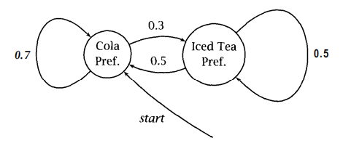
Hidden Markov Models
In an HMM, you don’t know the state sequence that the model passes through, but only some probabilistic function of it.
Suppose you have a crazy soft drink machine: it can be in two states, cola preferring (CP) and iced tea preferring (IP), but it switches between them randomly after each purchase.
Now, if, when you put in your coin, the machine always put out a cola if it was in the cola preferring state and an iced tea when it was in the iced tea preferring state, then we would have a visible Markov model

Slide 7
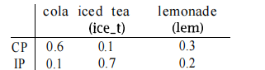
Hidden Markov Models
We need symbol emission probabilities for the observations:
For this machine, the output is actually independent of S_{j}, and so can be described by the following probability matrix:
What is the probability of seeing the output sequence {lem, ice-t} if the machine always starts off in the cola preferring state?

Slide 8
Hidden Markov Models
We need to consider all paths that might be taken through the HMM, and then to sum over them.
We know that the machine starts in state CP.
There are then four possibilities depending on which of the two states the machine is in at the other two time instants.
output sequence {lem, ice-t}
starts off in the cola preferring state
Possible combinations
CP-CP-CP, CP-CP-IP, CP-IP-CP, CP-IP-IP
0.7 x 0.3 x 0.7 x 0.1 + 0.7 x 0.3 x 0.3 x 0.1 + 0.3 x 0.3 x 0.5 x 0.7 + 0.3 x 0.3 x 0.5 x 0.7 = 0.084

Slide 9
What is the probability of seeing the output sequence {lem, ice-t} if the machine always starts off in the cola preferring state?
0.7
0.7
0.7
0.3
0.3
0.5
0.3
0.5
CP-CP-CP, CP-CP-IP, CP-IP-CP, CP-IP-IP
0.3
0.1
0.3
0.1
0.3
0.7
0.3
0.7
Lem
Ice-t
Lem
Ice-t
Lem
Ice-t
Lem
Ice-t
(0.7 x 0.3 x 0.7 x 0.1) + (0.7 x 0.3 x 0.3 x 0.1) + (0.3 x 0.3 x 0.5 x 0.7) + (0.3 x 0.3 x 0.5 x 0.7) = 0.084

Slide 10
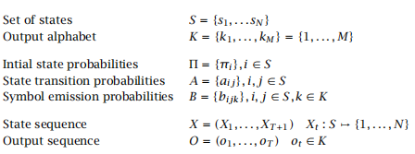
General form of an HMM
An HMM is specified by a five-tuple (S, K, Π, A, B), where S and K are the set of states and the output alphabet, and Π, A, and B are the probabilities for the initial state, state transitions, and symbol emissions, respectively
Notes:
In natural language processing, hidden states could represent parts of speech (e.g., noun, verb, adjective), and emission probabilities model the likelihood of observing a word given its part of speech.
In the context of HMMs, there are two main types of emission models:
Arc Emission (Continuous Emission):
In arc emission HMMs, the emission probabilities are modeled as continuous probability distributions. This means that for each hidden state, the emission probability distribution is a continuous distribution, such as a Gaussian (normal) distribution. The observable symbols are continuous variables, and the emission probabilities model the likelihood of observing a particular value from the continuous distribution given the current hidden state.
This type of emission model is often used in speech recognition where the acoustic features, such as spectral coefficients, are continuous values.
State Emission (Discrete Emission):
In state emission HMMs, the emission probabilities are modeled as discrete probability distributions. Each hidden state is associated with a set of discrete symbols or observations, and the emission probabilities represent the probability of emitting one of these symbols when in that state.
This type of emission model is common in natural language processing tasks, where the observable symbols are discrete words or symbols, and the emission probabilities model the likelihood of generating each word from the underlying hidden state (e.g., part of speech).
In summary, HMMs use both state transition probabilities and emission probabilities to model sequences of observable symbols generated by an underlying sequence of hidden states. The choice between arc emission and state emission depends on the nature of the observable symbols and the application domain.
Regenerate

Slide 11
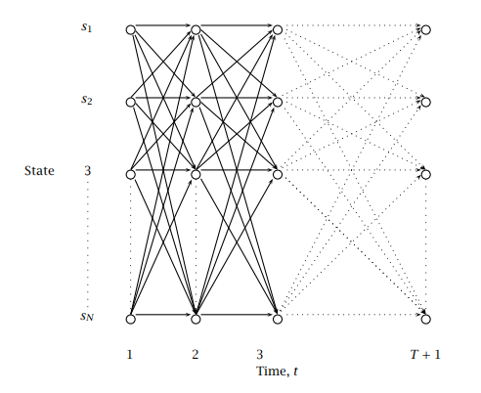
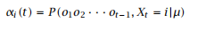
Finding the probability of an observation
Trellis algorithms.
The trellis is a square array of states versus times.
A node at (s_{i},t) can store information about state sequences which include X_{t} = i.
The lines show the connections between nodes.
Here we have a fully interconnected HMM where one can move from any state to any other at each step.
Trellis - The forward procedure:
The form of caching is called the forward procedure.
We describe it in terms of forward variables:
The forward variable α_{i}(t) is stored at (s_{i},t) in the trellis and expresses the total probability of ending up in state s_{i} at time t (given that the observations o₁ ··· o_{t-1} were seen).

Slide 12
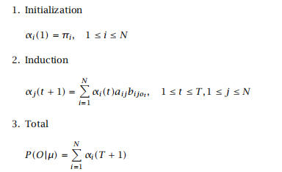
Trellis - The forward procedure:
It is calculated by summing probabilities for all incoming arcs at a Trellis node.
We calculate the forward variables in the trellis left to right using the following procedure:

Slide 13
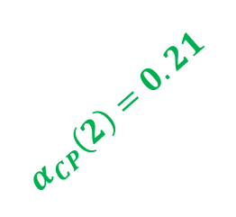
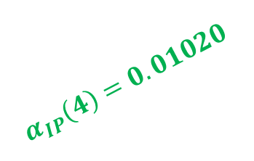
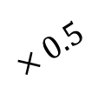
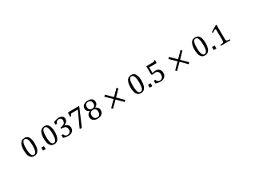
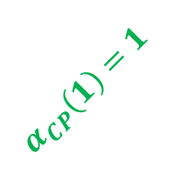
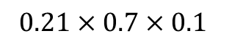
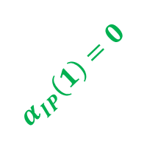
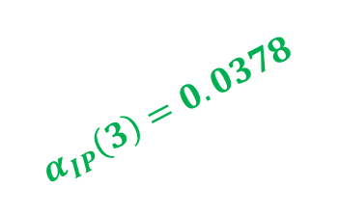
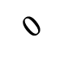
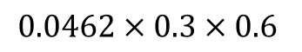
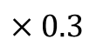
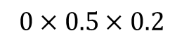
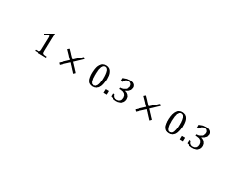
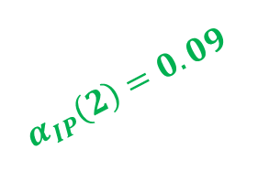
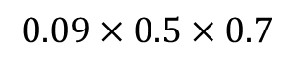
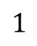
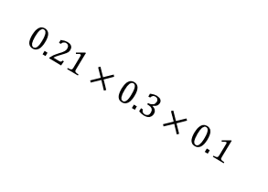
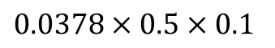
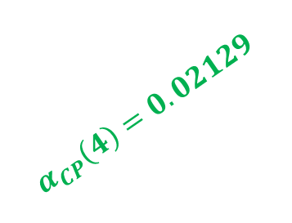
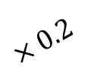
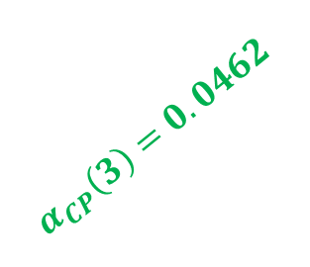
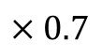
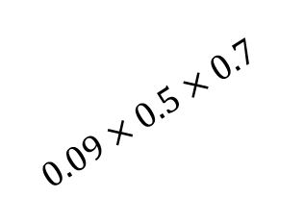
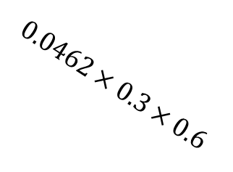
What is the probability of seeing the output sequence {lem, ice-t, cola} if the machine always starts off in the cola preferring state?
Lem
Ice-t
Cola
$$α_{CP}\left(2\right)=0.21$$
$$α_{CP}\left(3\right)=0.0462$$
$$α_{CP}\left(4\right)=0.02129$$
$$α_{CP}\left(1\right)=1$$
$$1$$
$$×0.7$$
$$×0.3$$
$$0.21×0.7×0.1$$
$$0.0462×0.3×0.6$$
CP
CP
CP
CP
$$×0.2$$
$$×0.5$$
$$0$$
$$0.09×0.5×0.7$$
$$0.0378×0.5×0.1$$
$$1×0.3×0.3$$
$$0.21×0.3×0.1$$
$$0.0462×0.3×0.6$$
IP
$$0×0.5×0.2$$
IP
$$0.09×0.5×0.7$$
IP
IP
$$0.0378×0.5×0.1$$
$$α_{IP}\left(1\right)=0$$
$$α_{IP}\left(2\right)=0.09$$
$$α_{IP}\left(3\right)=0.0378$$
$$α_{IP}\left(4\right)=0.01020$$
Forward Procedure
$${{P\left(Lem, Ice−t,Cola\right)=α}_{CP}\left(4\right)+α}_{IP}\left(4\right)=0.02129+0.01020=0.0315$$

Slide 14
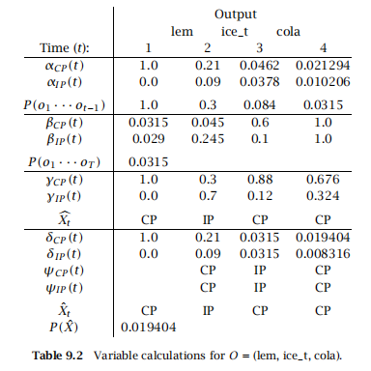
Forward Procedure Output Summary

Slide 15
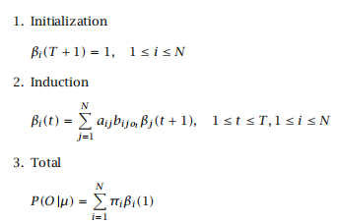
Finding the probability of an observation
Trellis - The backward procedure:
It should be clear that we do not need to cache results working forward through time like this, but rather that we could also work backward.
The backward procedure computes backward variables which are the total backward procedure probability of seeing the rest of the observation sequence given that we were in state s_{i} at time t.
Then we can calculate backward variables working from right to left through the trellis as follows:
The real reason for introducing this less intuitive calculation, though, is because use of a combination of forward and backward probabilities is vital for solving the third problem of parameter reestimation.
Define backward variables
β_{i}(t) = P (o_{t} ··· o_{T} |X_{t} = i,µ)

Slide 16
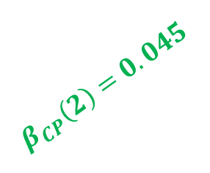
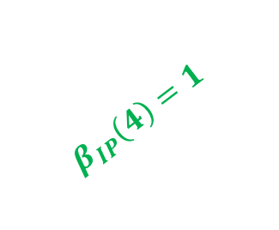
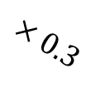
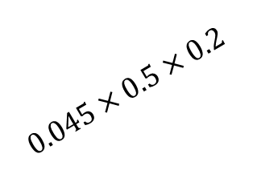
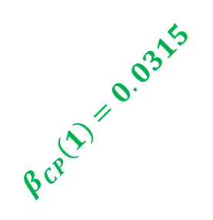
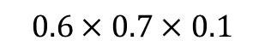
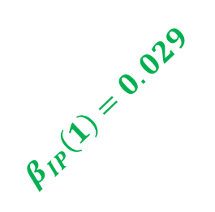
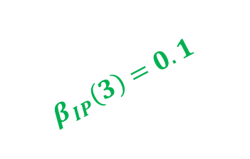
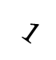
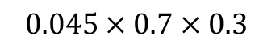
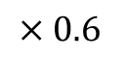
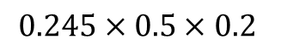
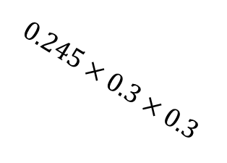
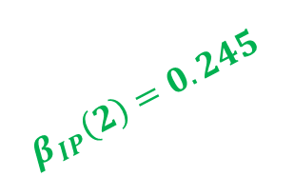
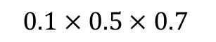
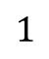
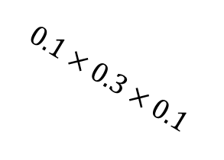

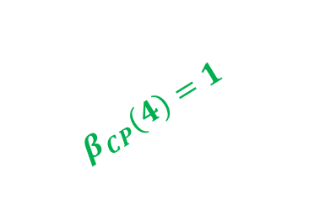





What is the probability of seeing the output sequence {lem, ice-t, cola} if the machine always starts off in the cola preferring state?
Lem
Ice-t
Cola
$$β_{CP}\left(2\right)=0.045$$
$$β_{CP}\left(3\right)=0.6$$
$$β_{CP}(4)=1$$
$$β_{CP}\left(1\right)=0.0315$$
CP
$$0.045×0.7×0.3$$
CP
$$0.6×0.7×0.1$$
CP
$$1$$
$×0.$7
$$×0.6$$
CP
$$1$$
$$0.045×0.5×0.2$$
$$0.245×0.3×0.3$$
$$0.6×0.5×0.7$$
$$0.1×0.3×0.1$$
$$1×0.5×0.1$$
$$×0.3$$
$$×0.6$$
IP
$$0.245×0.5×0.2$$
IP
$$0.1×0.5×0.7$$
IP
$$1×0.5×0.1$$
IP
$$β_{IP}\left(1\right)=0.029$$
$$β_{IP}\left(2\right)=0.245$$
$$β_{IP}\left(3\right)=0.1$$
$$β_{IP}\left(4\right)=1$$
Backward Procedure
$${{P\left(Lem, Ice−t,Cola\right)=π}_{CP}\left(1\right)×β_{CP}\left(1\right)+π}_{IP}\left(1\right)×β_{IP}\left(1\right)=1×0.0315+0×0.029=0.0315$$

Slide 17
Forward & Backward Procedure Output Summary

Slide 18

Finding the best state sequence
The second problem is “finding the state sequence that best explains the observations.”
One way to proceed would be to choose the states individually.
That is, for each t, 1 ≤ t ≤ T + 1, we would find X_{t} that maximizes P (X_{t}|O,µ).
This quantity maximizes the expected number of states that will be guessed correctly.
However, it may yield a quite unlikely state sequence.
Therefore, this is not the method that is normally used, but rather the Viterbi algorithm, which efficiently computes the most likely state sequence.

Slide 19








What is the probability of seeing the output sequence {lem, ice-t, cola} if the machine always starts off in the cola preferring state?
Lem
Ice-t
Cola
$$α_{CP}\left(2\right)=0.21$$
$$α_{CP}\left(3\right)=0.0462$$
$$α_{CP}\left(4\right)=0.02129$$
$$β_{CP}\left(2\right)=0.045$$
$$β_{CP}\left(3\right)=0.6$$
$$α_{CP}\left(1\right)=1$$
$$β_{CP}(4)=1$$
$$β_{CP}\left(1\right)=0.0315$$
CP
CP
CP
CP
IP
IP
IP
IP
$$α_{IP}\left(2\right)=0.09$$
$$α_{IP}\left(1\right)=0$$
$$β_{IP}\left(2\right)=0.245$$
$$α_{IP}\left(3\right)=0.0378$$
$$β_{IP}\left(1\right)=0.029$$
$$β_{IP}\left(3\right)=0.1$$
$$β_{IP}\left(4\right)=1$$
$$α_{IP}\left(4\right)=0.01020$$
Best Sequence

Slide 20

Best State Sequence Calculation
$$γ_{CP}\left(1\right)=\frac{α_{CP}\left(1\right)×β_{CP}(1)}{α_{CP}\left(1\right)×β_{CP}(1)+α_{IP}\left(1\right)×β_{IP}(1)}$$
$$γ_{CP}(1)=\frac{1×0.0315}{1×0.0315+0×0.029}=1$$
$$γ_{IP}(1)=\frac{0×0.029}{1×0.0315+0×0.029}=0$$
$$γ_{CP}(2)=\frac{0.21×0.045}{0.21×0.045+0.09×0.245}=0.3$$
$$γ_{IP}(2)=\frac{0.09×0.245}{0.21×0.045+0.09×0.245}=0.7$$
$$γ_{CP}(3)=\frac{0.0462×0.6}{0.0462×0.6+0.0378×0.1}=0.88$$
$$γ_{IP}(3)=\frac{0.0378×0.1}{0.0462×0.6+0.0378×0.1}=0.12$$
$$γ_{CP}(4)=\frac{0.02129×1}{0.02129×1+0.01020×1}=0.676$$
$$γ_{IP}(4)=\frac{0.01020×1}{0.02129×1+0.01020×1}=0.324$$
CP-IP-CP-CP

Slide 21
Forward/Backward Procedure & Best State Sequence Output Summary

Slide 22
Viterbi Algorithm
For any model, such as an HMM, that contains hidden variables, the task of determining which sequence of variables is the underlying source of some sequence of observations is called the decoding task.
In the ice-cream domain, given a sequence decoding of ice-cream observations 3 1 3 and an HMM, the task of the decoder is to find the best hidden weather sequence (H H H).
More formally, Decoding: Given as input an HMM μ = (A,B) and a sequence of observations O = o₁,o₂,...,o_{T} , find the most probable sequence of states Q = q₁q₂q₃ ...q_{T} .
We might propose to find the best sequence as follows:
For each possible hidden state sequence (HHH, HHC, HCH, etc.), we could run the forward algorithm and compute the likelihood of the observation sequence given that hidden state sequence.
Then we could choose the hidden state sequence with the maximum observation likelihood.
It should be clear from the previous section that we cannot do this because there are an exponentially large number of state sequences.

Slide 23

The Three Fundamental Questions for HMMs
Viterbi Algorithm
Using dynamic programming, we calculate the most probable path through the whole trellis as follows

Slide 24















Finding the best state sequence: Viterbi
$$δ_{CP}\left(3\right)=max(0.0147,0.0315)$$
$$δ_{CP}\left(4\right)=max(0.01323,0.00157)$$
$$δ_{CP}\left(2\right)=max(0.21,0)$$
$$Ψ_{CP}\left(4\right)=CP$$
Lem
Ice-t
Cola
$$Ψ_{CP}\left(3\right)=IP$$
$$Ψ_{CP}\left(2\right)=CP$$
$$δ_{CP}\left(1\right)=1$$
$$1$$
$$×0.7$$
$$×0.3$$
$$0.21×0.7×0.1$$
$$0.0462×0.3×0.6$$
CP
CP
CP
CP
$$×0.2$$
$$×0.5$$
$$0$$
$$0.09×0.5×0.7$$
$$0.0378×0.5×0.1$$
$$1×0.3×0.3$$
$$0.21×0.3×0.1$$
$$0.0462×0.3×0.6$$
IP
$$0×0.5×0.2$$
IP
$$0.09×0.5×0.7$$
IP
IP
$$0.0378×0.5×0.1$$
$$δ_{IP}\left(1\right)=0$$
$$δ_{IP}\left(2\right)=max(0.09,0)$$
$$δ_{IP}\left(4\right)=max(0.00567,0.001575)$$
$$Ψ_{IP}\left(2\right)=CP$$
$$δ_{IP}\left(3\right)=max(0.0063,0.0315)$$
$$Ψ_{IP}\left(3\right)=IP$$
$$Ψ_{IP}\left(4\right)=CP$$

Slide 25










$$Ψ_{i}\left(t+1\right) Calculation$$
$$δ_{CP}\left(1\right)=1$$
$$δ_{CP}\left(2\right)=max(0.21,0)$$
$$Ψ_{CP}\left(2\right)=CP$$
$$δ_{CP}\left(3\right)=max(0.0147,0.0315)$$
$$Ψ_{CP}\left(3\right)=IP$$
$$δ_{CP}\left(4\right)=max(0.01323,0.00157)$$
$$Ψ_{CP}\left(4\right)=CP$$
$$δ_{IP}\left(1\right)=0$$
$$δ_{IP}\left(2\right)=max(0.09,0)$$
$$Ψ_{IP}\left(2\right)=CP$$
$$δ_{IP}\left(3\right)=max(0.0063,0.0315)$$
$$Ψ_{IP}\left(3\right)=IP$$
$$δ_{IP}\left(4\right)=max(0.00567,0.001575)$$
$$Ψ_{IP}\left(4\right)=CP$$

Slide 26





Output Summary
$$0.01323$$
$$0.00567$$
$$Max(P(δ_{CP}\left(T+1\right),δ_{IP}\left(T+1\right)))$$
$$0.01323$$
$$Probability of best sequence: Max(P(δ_{CP}\left(T+1\right),δ_{IP}\left(T+1\right)))$$

Slide 27


Slide 28


Slide 29


Slide 30


Slide 31



Slide 32


Slide 33


In the above sentences, the word Mary appears four times as a noun.

Slide 34




Slide 35



Slide 36


Slide 37


Slide 38



Slide 39


Slide 40


Slide 41


Slide 42


Slide 43


Slide 44


Slide 45


Slide 46


Slide 47


Slide 48


Example: Multiple Linear Regression Suppose we have the following dataset with one response variable y and two predictor variables X1 and X2:

Slide 49


Slide 50


Slide 51


Slide 52


Slide 53


Slide 54


Slide 55


Slide 56



Slide 57



Slide 58



Slide 59



Slide 60



Slide 61

ComparisonofRegularizationTechniques

Slide 62


Slide 63
Class Work Problem
A Hidden Markov Model (HMM) has two states {A1, A2} with initial probabilities π(A1) = 1 and π(A2) = 0. It can emit two observations {X1, X2}. Find the probability of the output sequence X1, X2, X1 using the forward and backward procedure.
From \ To | A1 | A2
A1 | 0.7 | 0.3
A2 | 0.4 | 0.6
State | P(X1) | P(X2)
A1 | 0.6 | 0.4
A2 | 0.3 | 0.7

Slide 64

Linear Regression
Consider the following dataset of points:
$\left(x , y\right)=\left\{\left(1 , 2\right) , \left(2 , 3\right) , \left(3 , 5\right) , \left(4 , 7\right) , \left(5 , 8\right)\right\}$
Fit a linear regression line $y=a+bx$ using the least squares method.
Compute the values of $a$(intercept) and $b$(slope).
Using your regression equation, predict the value of $y$when $x=6$.

